Slide 1
Mechanical Energy conversion principles

Slide 2

contents
Turbine definition
Working principles
Types of turbine
Water Turbine :
A) impulse turbine B) reaction turbine
Steam Turbine
Gas Turbine
Wind Turbine

Slide 3



What is a TURBINE???
A turbine is a rotary mechanical device that extracts energy from a fast moving flow of water, steam, gas, air, or other fluid and converts it into useful work.
A turbine is a turbo-machine with at least one moving part called a rotor assembly, which is a shaft or drum with blades attached.
Moving fluid acts on the blades so that they move and impart rotational energy to the rotor.

Slide 4


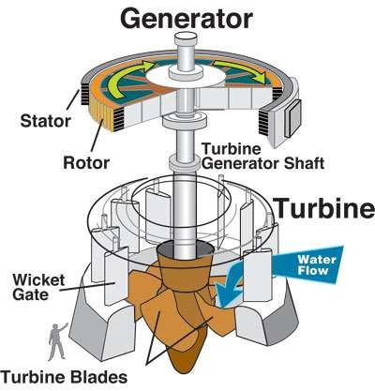
WORKING PRINCIPLE:
The working principle is very much simple.
When the fluid strikes the blades of the turbine, the blades are displaced, which produces rotational energy.
When the turbine shaft is directly coupled to an electric gene-
-rator mechanical energy is converted into electrical energy.
This electrical power is known as hydroelectric power.

Slide 5

Basic types of turbines
Water Turbine :
A) impulse turbine B) reaction turbine
Steam Turbine
Gas Turbine
Wind Turbine
Although the same principles apply to all turbines, their specific designs differ sufficiently to merit separate descriptions.

Slide 6

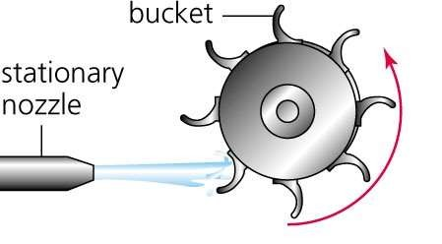
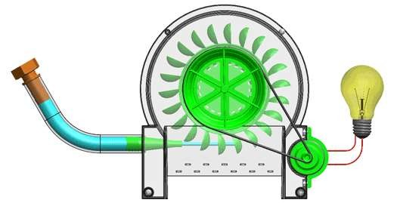
Impulse Turbine
In an impulse turbine, the fluid is forced to hit the turbine at high speed.
Types of Impulse Turbines:
Pelton Turbine
Cross-flow Turbine
Pelton Wheel

Slide 7
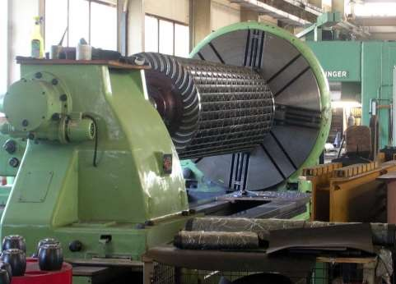
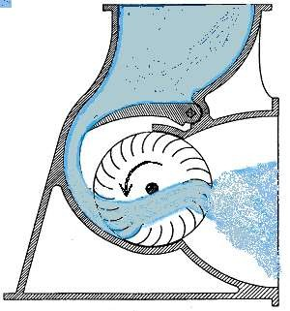
Cross-flow Turbine
As with a water wheel, the water is admitted at the turbine's edge. After passing the runner, it leaves on the opposite side.
Going through the runner twice provides additional efficiency.
The cross-flow turbine is a low-speed machine that is well suited for locations with a low head but high flow.

Slide 8


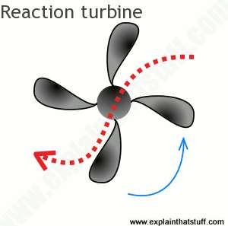
Reaction Turbine
In a reaction turbine, forces driving the rotor are achieved by the reaction of an accelerating water flow in the runner while the pressure drops.
In reaction turbines torque developed by reacting to the fluid's
pressure. The pressure of the fluid
changes as it passes through the turbine rotor blades.
Types of Reaction Turbines
Kaplan Turbine Francis Turbine Kinetic Turbine

Slide 9

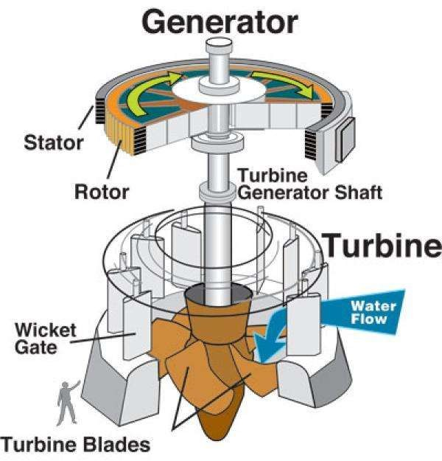
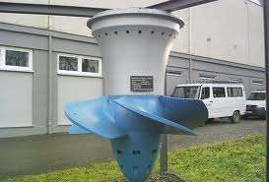
Kaplan Turbine
The Kaplan turbine is a water turbine which has adjustable blades and is used for low heads and high discharges.
The Kaplan turbine is an inward flow reaction turbine, which means that the working fluid changes pressure as it moves through the turbine and gives up its energy.

Slide 10

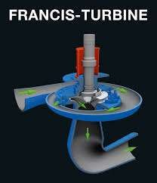
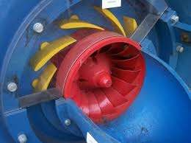
Francis Turbine
The Francis turbine is a type of water turbine and are used for medium head(45-400 m) and medium discharge.(10-700 m^3/s)
The Francis turbine is a type of reaction turbine, a category of turbine in which the working fluid comes to the turbine under immense pressure and the energy is extracted by the turbine blades from the working fluid.

Slide 11

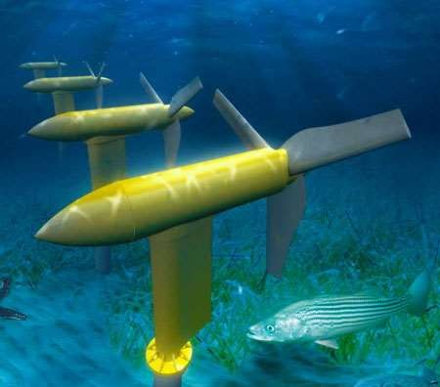
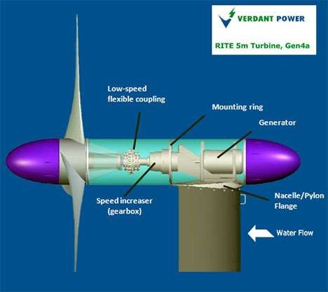
Kinetic Turbines
Kinetic energy turbines, also called free-flow turbines, generate electricity from the kinetic energy present in flowing water.
The systems may operate in rivers, man-made channels, tidal
waters, or ocean currents.
Kinetic systems utilize the water stream's natural pathway.

Slide 12



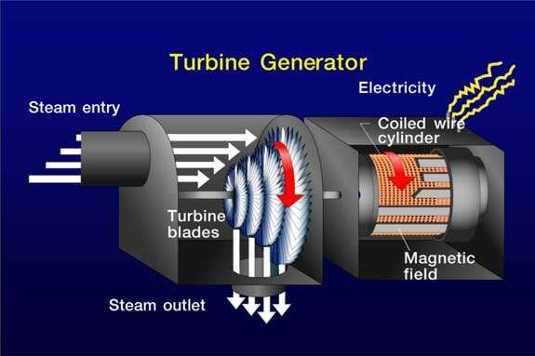
Steam Turbine
A
steam turbine is a device that extracts thermal
energy from pressurized steam and uses it to do mechanical work on a rotating output shaft.
Steam turbines are used for the generation of electricity in thermal power plants, such as plants using coal fuel oil or nuclear fuel.

Slide 13



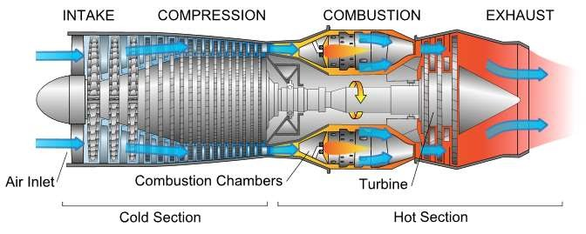
Gas turbine
A gas turbine, also called a combustion turbine, is a type of internal combustion engine.
Gas turbines are used to power aircraft, trains, ships, electrical generators or even tanks.

Slide 14

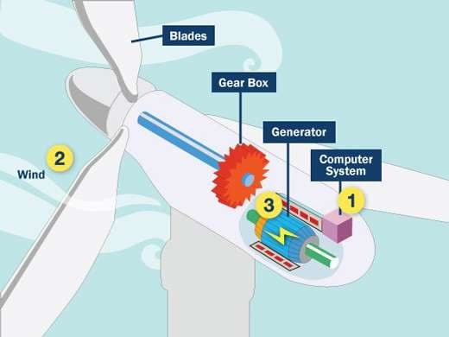
Wind Turbine
A wind turbine is a device that converts kinetic energy from the wind into electrical power .
Conventional horizontal axis turbines can be divided into three
components:.
Wind turbine used for charging batteries may be referred to as a wind charger.

